Slide 1
L E C T U R E
6
SOFTWARE PROCESS AND PROJECT METRICS
Notes:
This repository of slides is intended to support the named chapter. The slide repository should be used as follows:
Copy the file to a unique name for your course and unit.
Edit the file by deleting those slides you don’t want to cover, editing other slides as appropriate to your course, and adding slides as desired.
Print the slides to produce transparency masters or print directly to film or present the slides using a computer image projector.
Each slide includes instructor notes. To view those notes in PowerPoint, click-left on the View Menu; then click left on Notes View sub-menu. You may need to scroll down to see the instructor notes.
The instructor notes are also available in hardcopy as the Instructor Guide to Accompany Systems Analysis and Design Methods, 5/ed.

Slide 2
Software Process and Project Metrics
SOFTWARE PROCESS AND PROJECT METRICS
What is it?
Who does it?
Why is it important?
What are the steps?
What is the work product?
How do I ensure that I’ve done it right?

Slide 3
What is it?
Software Metrics provide measures for various aspects of software process and software product.

Slide 4
Software metrics refers to a broad range of measurements for computer software.
Measurement can be applied to the software process with the intent of improving it on a continuous basis. Measurement can be used throughout a software project to assist in
estimation,
quality control,
productivity assessment, and
project control.
Finally, measurement can be used by software engineers to help assess the quality of technical work products and to assist in tactical decision making as a project proceeds.

Slide 5
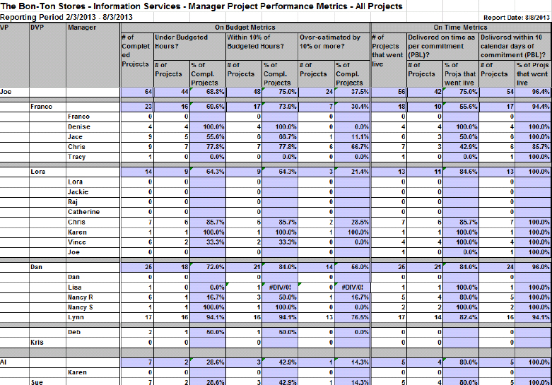

Slide 6
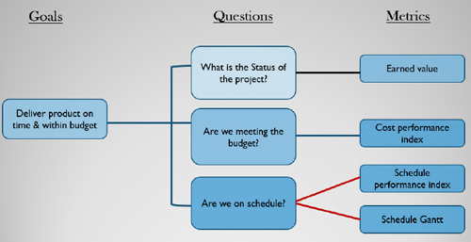

Slide 7
What guidelines should be applied when we collect software metrics?
Use common sense and organizational sensitivity when interpreting metrics data.
Provide regular feedback to the individuals and teams who collect measures and metrics.
Don’t use metrics to appraise individuals.
Work with practitioners and teams to set clear goals and metrics that will be used to achieve them.
Never use metrics to threaten individuals or teams.
Metrics data that indicate a problem area should not be considered “negative.” These data are merely an indicator for process improvement.
Don’t obsess on a single metric to the exclusion of other important metrics.

Slide 8
An organization becomes more comfortable with the collection and use of process metrics.
The derivation of simple indicators gives way to a more rigorous approach called statistical software process improvement(SSPI).

Slide 9
Failure analysis works in the following manner:
1.All errors and defects are categorized by origin (e.g., flaw in specification, flaw in logic, nonconformance to standards).
2. The cost to correct each error and defect is recorded.
3. The number of errors and defects in each category is counted and ranked in descending order.
4. The overall cost of errors and defects in each category is computed.
5. Resultant data are analyzed to uncover the categories that result in highest cost to the organization.
6. Plans are developed to modify the process with the intent of eliminating (or reducing the frequency of) the class of errors and defects that is most costly.

Slide 10
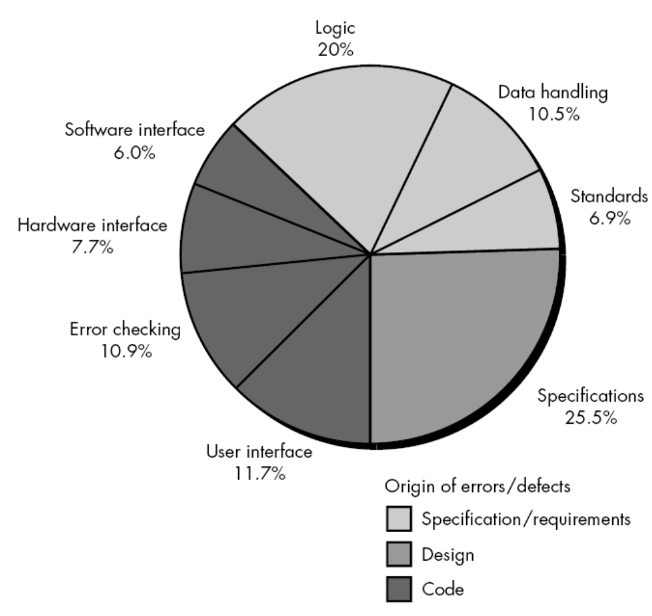
FIGURE
Causes of defects and their origin for four software projects

Slide 11
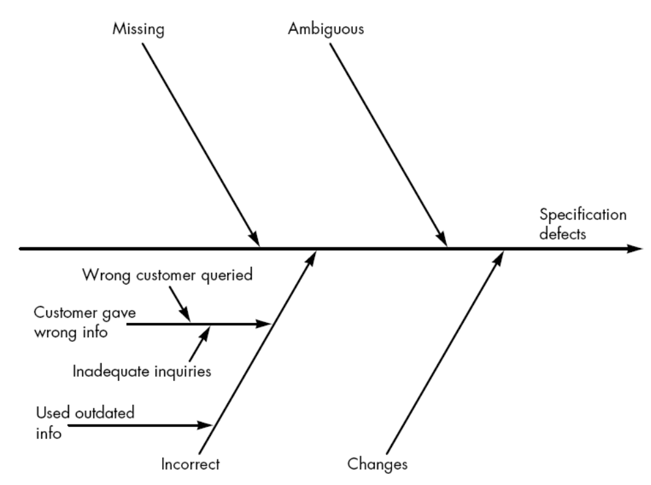
A fishbone diagram

Slide 12
The collection of process metrics is the driver for the creation of the fishbone diagram. A completed fishbone diagram can be analyzed to derive indicators that will enable a software organization to modify its process to reduce the frequency of errors and defects.

Slide 13
Project Metrics
Software process metrics are used for strategic purposes. Software project measures are tactical. That is, project metrics and the indicators derived from them are used by a project manager and a software team to adapt project work flow and technical activities.

Slide 14
SOFTWARE MEASUREMENT
Software metrics can be categorized similarly.
Direct measures of the software engineering process include cost and effort applied. Direct measures of the product include lines of code (LOC) produced, execution speed, memory size, and defects reported over some set period of time.
Indirect measures of the product include functionality, quality, complexity, efficiency, reliability, maintainability, and many other "–abilities"

Slide 15
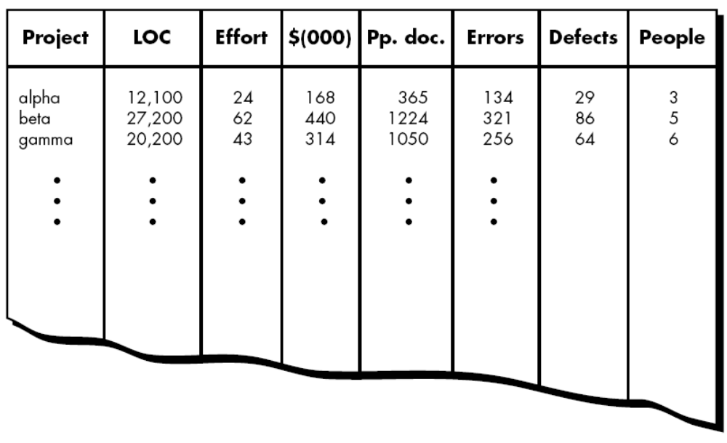
Size-oriented metrics

Slide 16
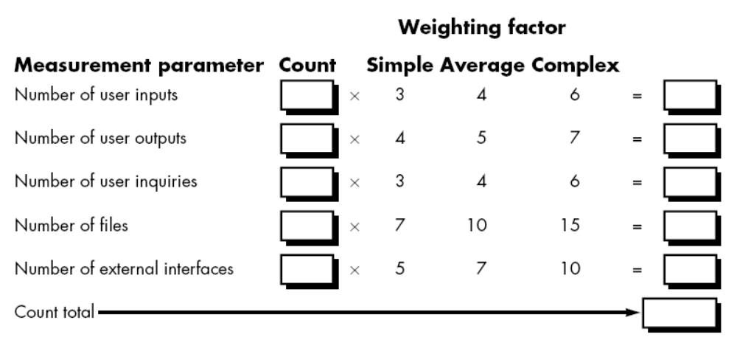
Function-Oriented Metrics
To compute function points (FP), the following relationship is used:
FP = count total [0.65 + 0.01 Σ(Fi)]
where count total is the sum of all FP entries obtained from Figure

Slide 17
The Fi (i = 1 to 14) are "complexity adjustment values" based on responses to the
following questions :
1. Does the system require reliable backup and recovery?
2. Are data communications required?
3. Are there distributed processing functions?
4. Is performance critical?
5. Will the system run in an existing, heavily utilized operational environment?
6. Does the system require on-line data entry?
7. Does the on-line data entry require the input transaction to be built over multiple screens or operations?
8. Are the master files updated on-line?
9. Are the inputs, outputs, files, or inquiries complex?
10. Is the internal processing complex?
11. Is the code designed to be reusable?
12. Are conversion and installation included in the design?
13. Is the system designed for multiple installations in different organizations?
14. Is the application designed to facilitate change and ease of use by the user?

Slide 18
Defect Removal Efficiency
What is defect removal efficiency?
A quality metric that provides benefit at both the project and process level is defect removal efficiency (DRE). In essence, DRE is a measure of the filtering ability of quality assurance and control activities as they are applied throughout all process framework activities.
When considered for a project as a whole, DRE is defined in the following manner:
DRE = E/(E + D)
where E is the number of errors found before delivery of the software to the end-user and D is the number of defects found after delivery.
The ideal value for DRE is 1. That is, no defects are found in the software. Realistically, D will be greater than 0, but the value of DRE can still approach 1.

Slide 19
ESTABLISHING A SOFTWARE METRICS PROGRAM
The Software Engineering Institute has developed a comprehensive guidebook [PAR96] for establishing a “goal-driven” software metrics program. The guidebook suggests the following steps:
1. Identify your business goals.
2. Identify what you want to know or learn.
3. Identify your sub goals.
4. Identify the entities and attributes related to your subgoals.
5. Formalize your measurement goals.
6. Identify quantifiable questions and the related indicators that you will use to
help you achieve your measurement goals.
7. Identify the data elements that you will collect to construct the indicators that
help answer your questions.
8. Define the measures to be used, and make these definitions operational.
9. Identify the actions that you will take to implement the measures.
10. Prepare a plan for implementing the measures.

Slide 20
metrics | ফলাফলের মান
appraise | মূল্যায়ন করা
threaten | ভীতিপ্রদর্শন করা
individuals | ব্যক্তি
merely | শুধু
obsess | প্রভাবিত করা
quantitative | পরিমাণগত
measurements | পরিমাপ
measures | ব্যবস্থা
essence | সারংশ
flaw | ত্রুটি
Resultant | পরিসমাপ্তি

